Slide 1
.NET 5: The Journey to One .NET Becomes Reality
Dave Brock (@daveabrock) MADdotNET – November 4, 2020

Slide 2





About Me
I am a:
Dad – Two “child components” aged 6 and 3
Software engineer – By day, I work at CUNA Mutual on building out Azure solutions for development teams. By night, I work with the dev community and on open source when time permits
Writer – I write a lot on the side about .NET and programming:
daveabrock.com – I write posts once a week about Blazor, ASP.NET Core, C#, and Azure
The .NET Stacks (dotnetstacks.com) – A weekly newsletter where I discuss trends, interview leaders, and provide weekly links
@daveabrock daveabrock.com
@dotnetstacks dotnetstacks.com

Slide 3
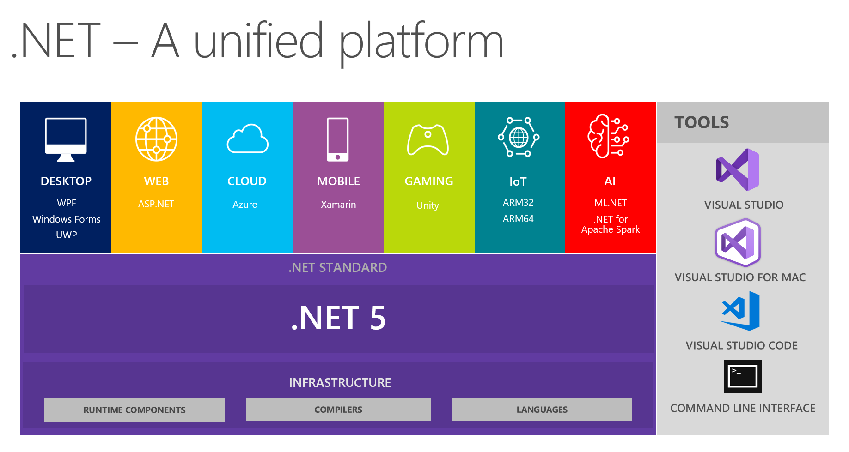
.NET 5 is here!
.NET 5 is the unified developer experience that promises a single .NET runtime and framework that can be used anywhere—one SDK, one BCL, one toolchain, cross-platform UIs, and cloud native and performance investments
@daveabrock daveabrock.com
@dotnetstacks dotnetstacks.com
bit.ly/brock-dotnet5

Slide 4
.NET 5: The Journey to One .NET Becomes Reality* (except for Xamarin)
Dave Brock (@daveabrock) MADdotNET – November 4, 2020

Slide 5
The transition
.NET Framework 4.8
Done, no more features (only fixes)
.NET Core 3.1
.NET 5
.NET 6
Mono / Xamarin
bit.ly/brock-immo-video
@daveabrock daveabrock.com
@dotnetstacks dotnetstacks.com

Slide 6

@daveabrock daveabrock.com
@dotnetstacks dotnetstacks.com

Slide 7
The state of .NET Framework
.NET Framework is “done, not dead”
.NET Framework 4.8 is the last major version, and Microsoft will only support bug, reliability, and security fixes
Your apps are safe: .NET Framework will be supported as long as Windows is supported (much of Windows depends on it!)
There are no plans to migrate:
Web Forms – use ASP.NET Core Blazor or Razor Pages
WCF – use gRPC
Windows Workflow – use CoreWF
@daveabrock daveabrock.com
bit.ly/brock-hunter-post
@dotnetstacks dotnetstacks.com

Slide 8
What’s up with about .NET Standard?
.NET Standard is a specification for .NET APIs that allow you to understand what is supported for all specifications on .NET—helping you build a bridge between .NET Framework and .NET Core
With “One .NET”, what happens now? No new versions of Standard, but .NET 5 will still support 2.1 and earlier
Use the following implementations:
netstandard2.0 – for sharing code with .NET Framework
netstandard2.1 – share code between Mono, Xamarin, and .NET Core 3.x
Use platform-specific ones (net5.0-windows, for example) as needed
net5.0 – for everything else moving forward. It combines and replace netcoreapp and netstandard
@daveabrock daveabrock.com
bit.ly/brock-net-standard
@dotnetstacks dotnetstacks.com

Slide 9
The future state for TFMs
.NET 5 | .NET 6
net5.0 | net6.0
net5.0-windows | net6.0-windows
 | net6.0-android
 | net6.0-ios
@daveabrock daveabrock.com
@dotnetstacks dotnetstacks.com

Slide 10
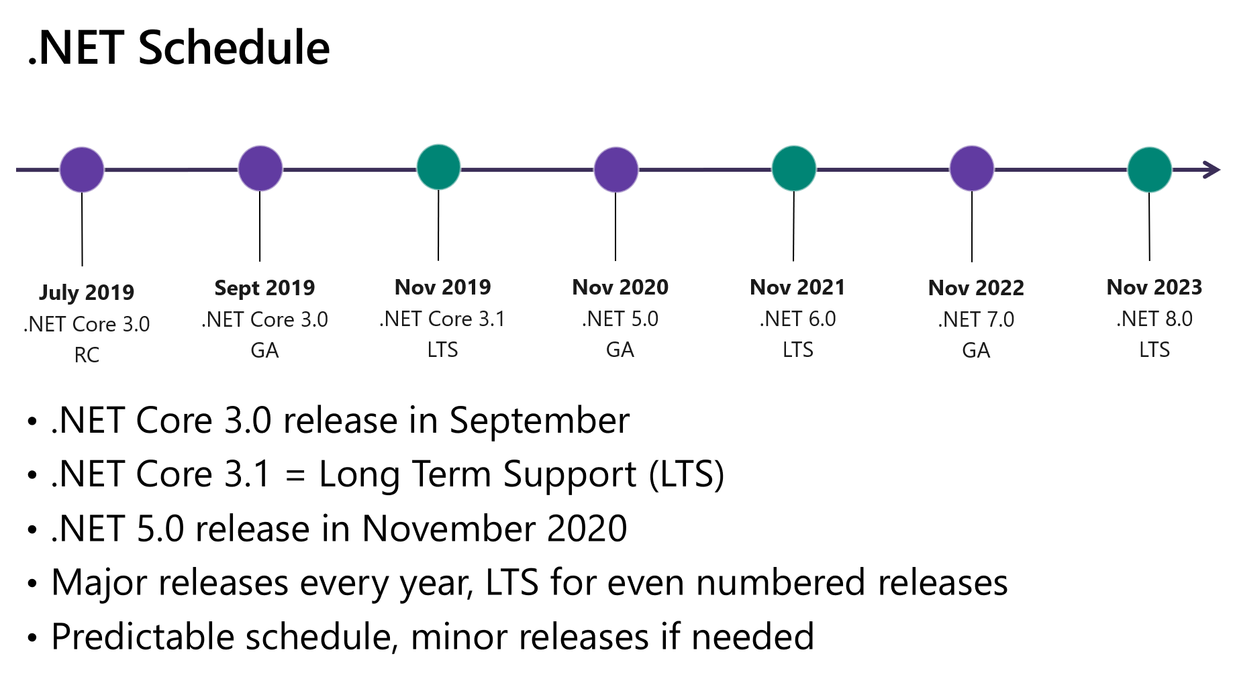
@daveabrock daveabrock.com
@dotnetstacks dotnetstacks.com

Slide 11
So … what’s new with .NET 5?
With .NET 5, we see a ton of improvements with:
Single file apps
ARM64 support
Performance improvements with System.Text.Json, System.Text.RegularExpressions
Container optimizations
App trimming
Nullable reference type annotations
F# 5 improvements
Tonight, we’ll geek out on:
C# 9
Blazor
EF Core 5
@daveabrock daveabrock.com
@dotnetstacks dotnetstacks.com

Slide 12
C# 9: Functionally Better
C# 9 ships with .NET 5 and Visual Studio 16.8!
After making nullability a big focus with C# 8, C# 9 brings a lot of great improvements
C# 9 welcomes a lot of work with immutability and core functional programming concepts
We can’t cover it all, but we’ll look at:
Top-level statements
Target typing
Init-only properties
Records
@daveabrock daveabrock.com
@dotnetstacks dotnetstacks.com

Slide 13
C# 9: Top-Level Programs
Top-level programs allow you to write code:
Which return anything
Without a traditional main method
With support for “magic parameters”
And allows local functions!
@daveabrock daveabrock.com
bit.ly/brock-toplevel-post
@dotnetstacks dotnetstacks.com

Slide 14
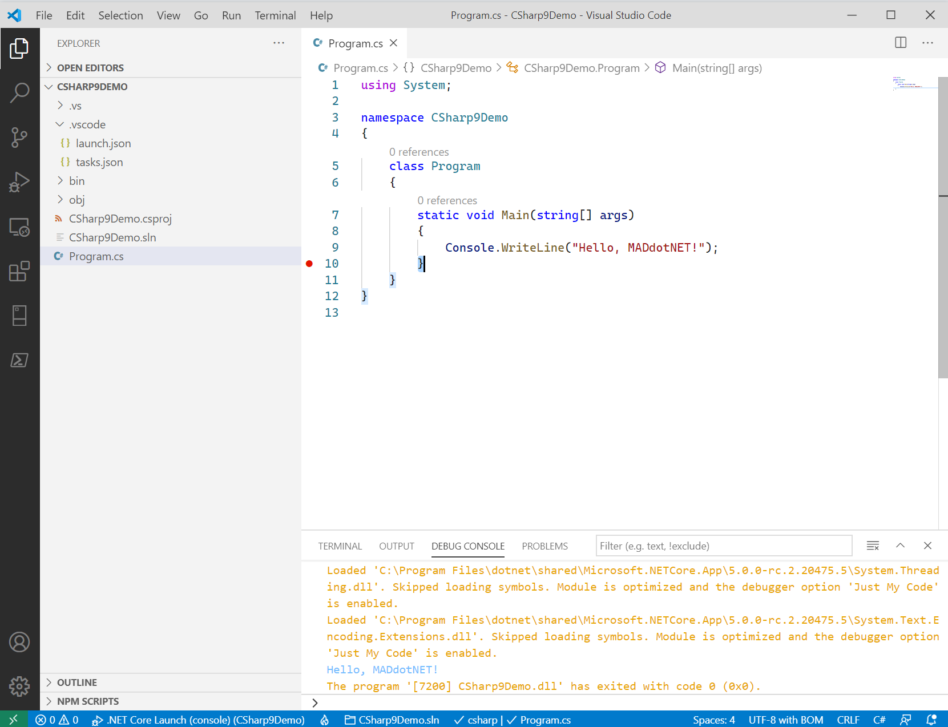
Notes:
This is a traditional console app.

Slide 15
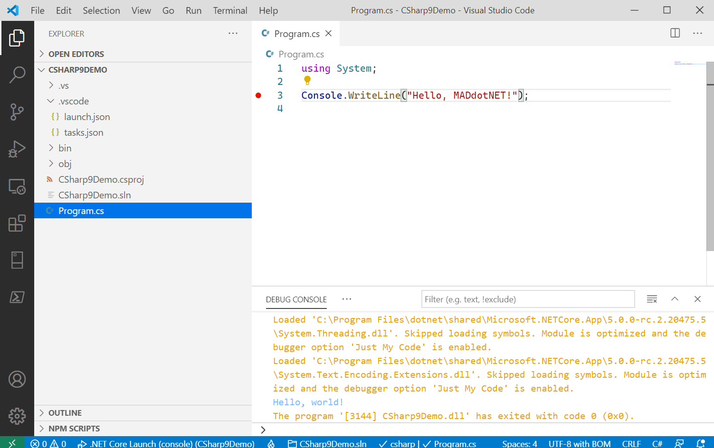
Notes:
Here’s a top-level statement with a using.

Slide 16
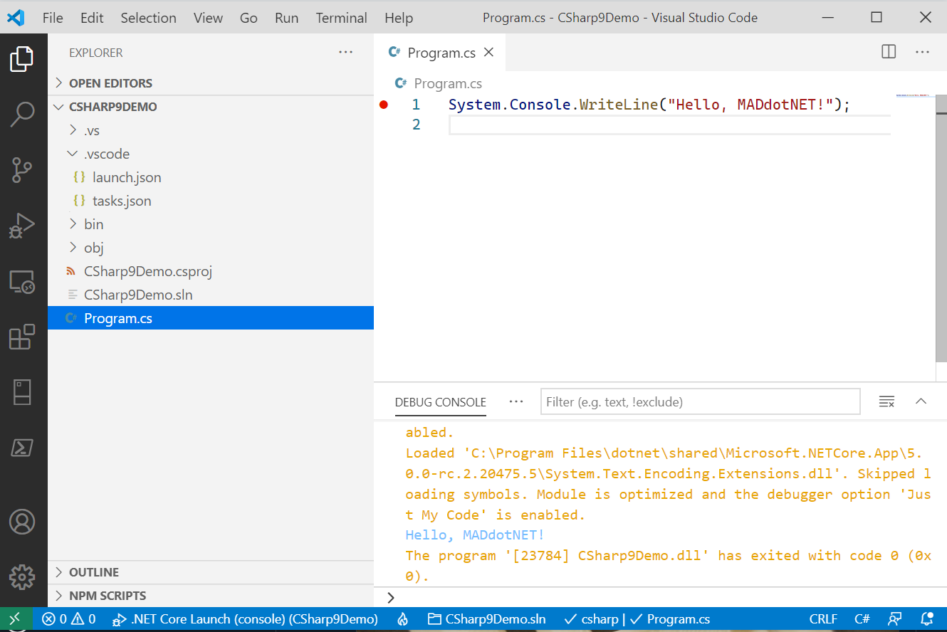
Notes:
Here’s a top-level statement without a using.

Slide 17
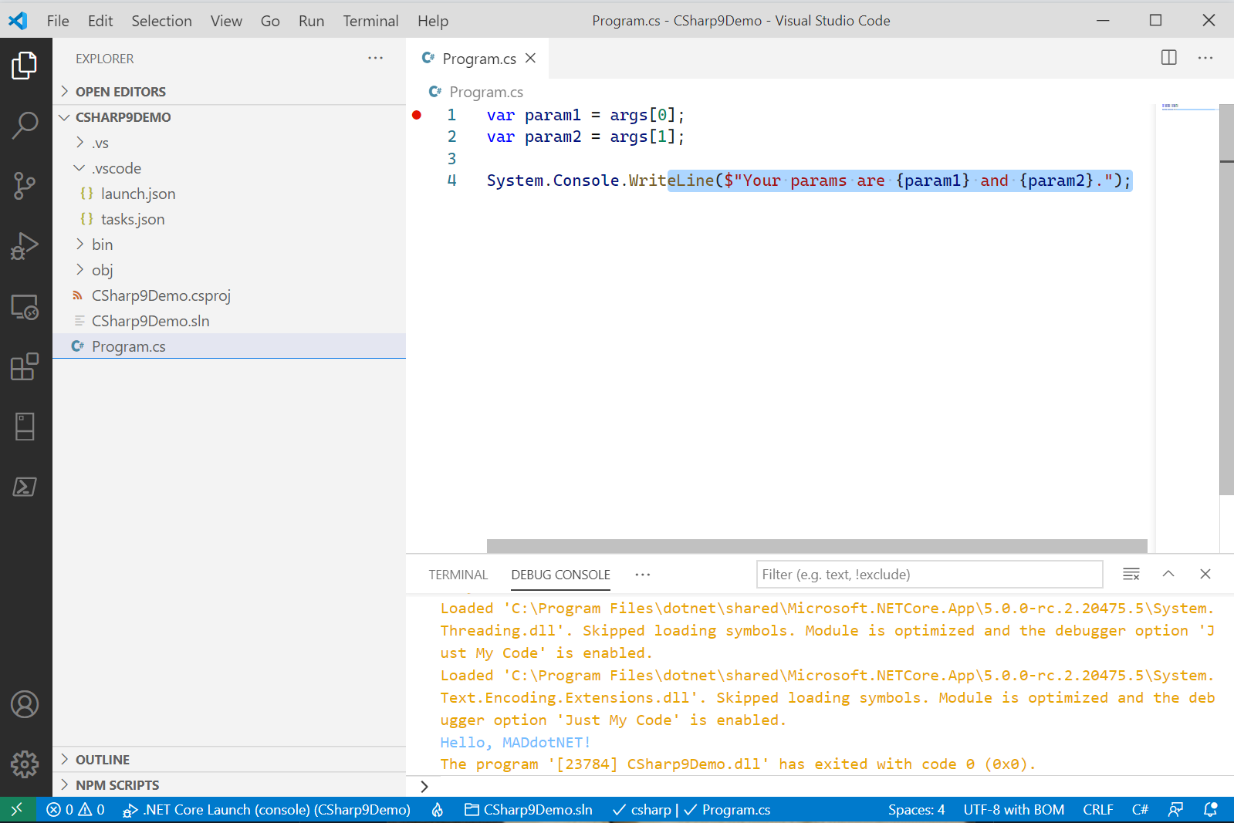
Notes:
Top-level statements also take in *magic* parameters.

Slide 18
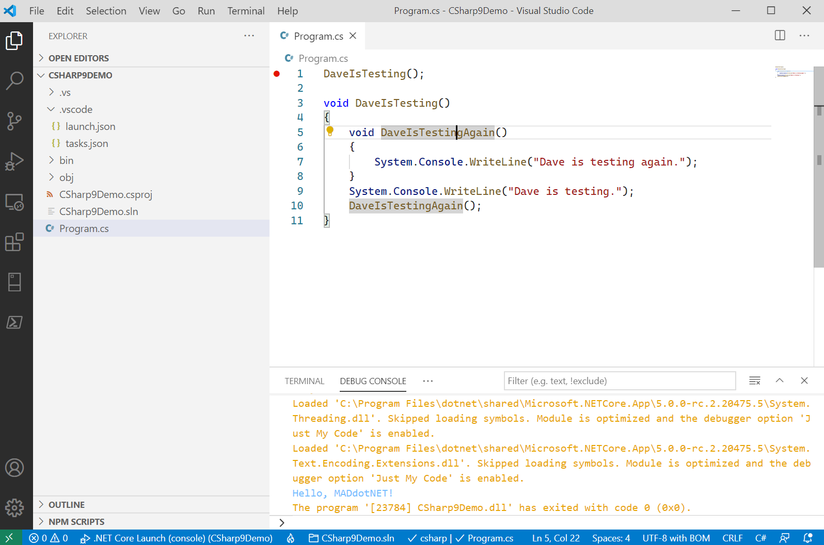
Notes:
Top-level statements also support local functions.

Slide 19
C# 9: Target Typing
Target typing:
Allows C# to get type from its context on the right side of the equals operator
As a result, you can’t pair it with the var keyword or ternary statements
Works great with collections
@daveabrock daveabrock.com
bit.ly/brock-target-post
@dotnetstacks dotnetstacks.com

Slide 20
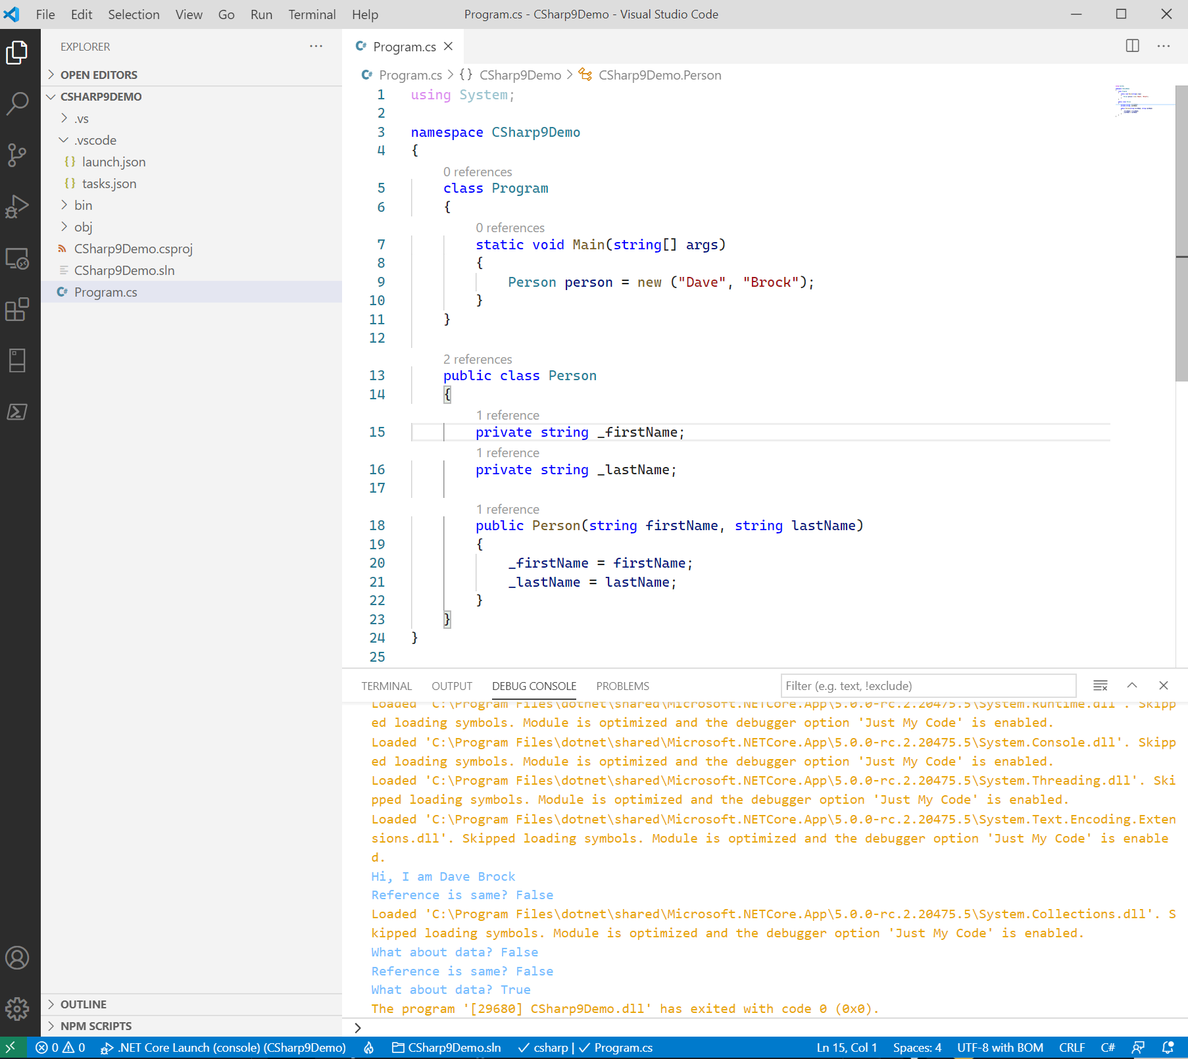
Notes:
Here’s a traditional use of it, when constructing an object

Slide 21
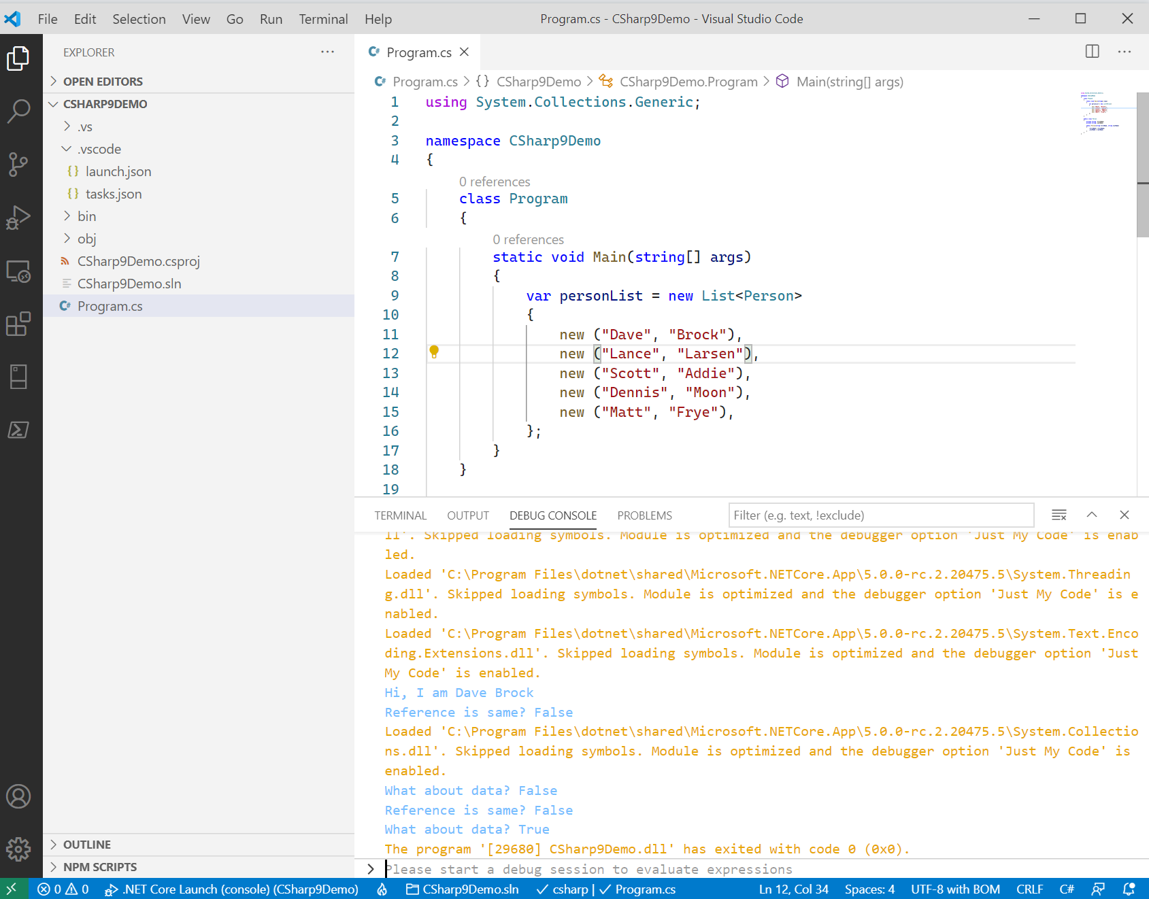
Notes:
Here’s how it works with collections

Slide 22
C# 9: Init-only properties
Init-only properties:
Allow you to have properties that resemble immutability
The init keyword prevents you from mutating an object after initialization/instantiation
You can now have immutability in object initializers
@daveabrock daveabrock.com
bit.ly/brock-inits
@dotnetstacks dotnetstacks.com

Slide 23
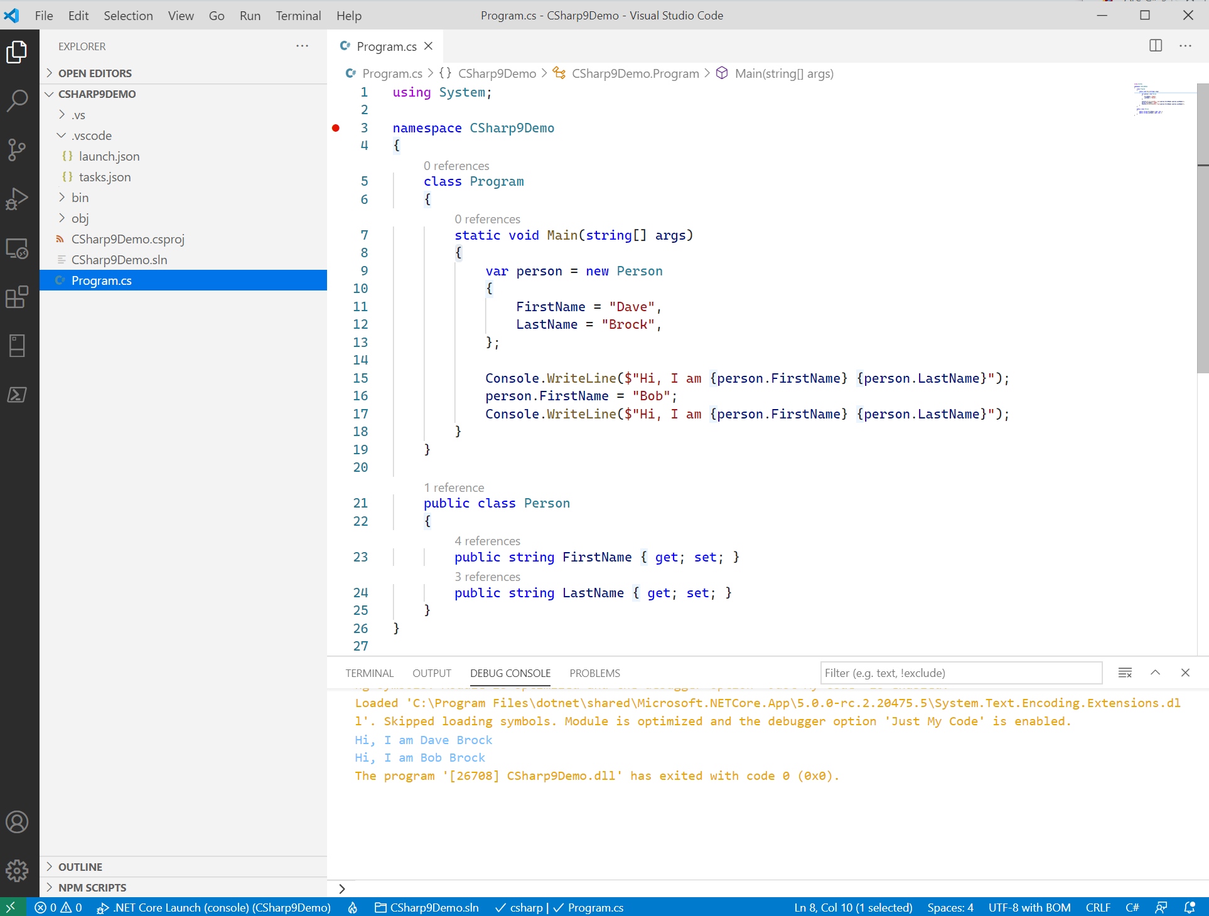
Notes:
Here’s how you’d typically mutate an object.

Slide 24
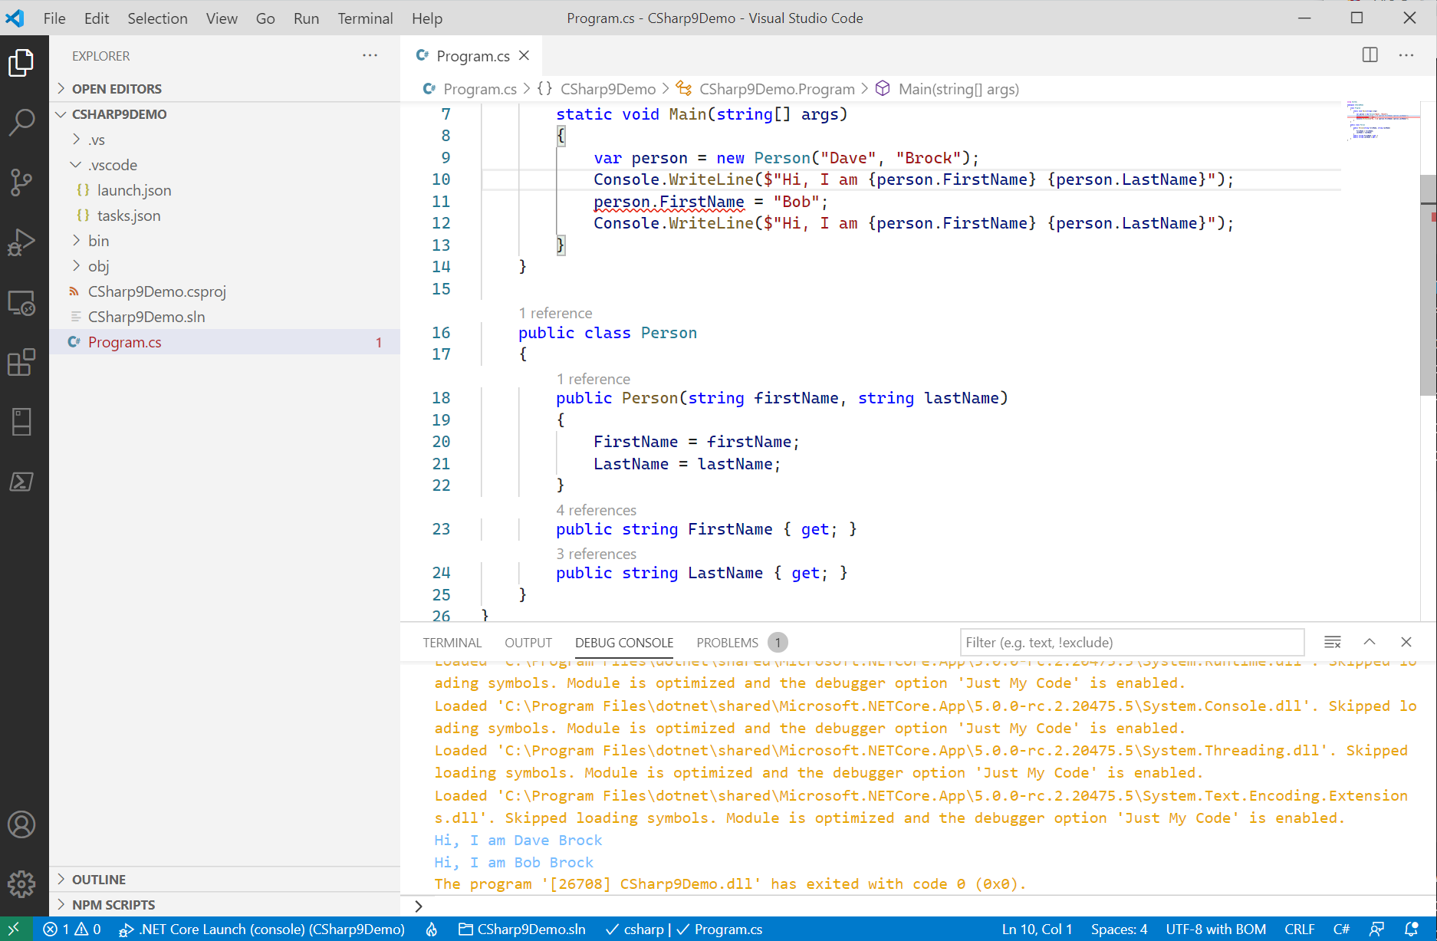
Notes:
You can typically mimic this in C# 8 using readonly properties.

Slide 25
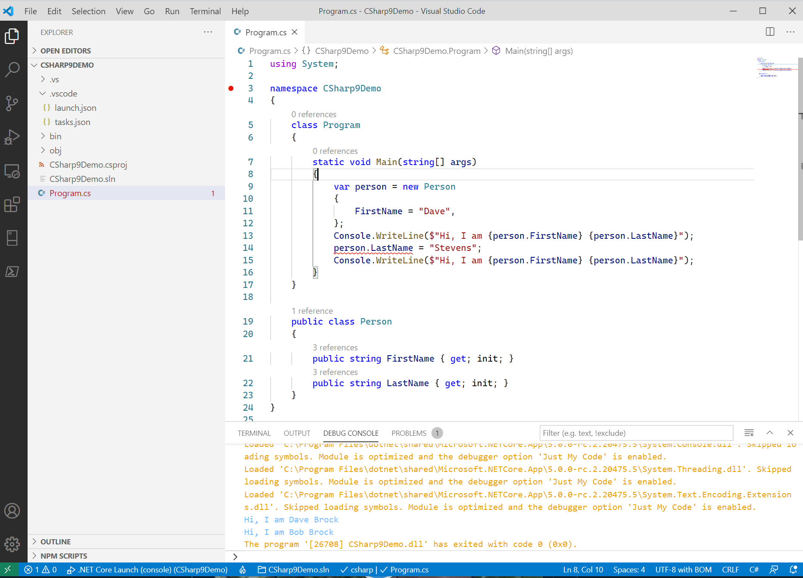
Notes:
Init properties are optional, but it doesn’t mean you can set after instantiation

Slide 26
C# 9: Records
Records are the core feature in C# 9
Records allow you:
To work with immutable types (think immutable data classes)
To perform data-like behaviors on properties
Are struct-like, but:
Provide an easy construct with the purpose of providing immutability
Provides support for IEquatable<T> interface without having to override them (but you can)
Constructor/deconstructor support
@daveabrock daveabrock.com
bit.ly/brock-records
@dotnetstacks dotnetstacks.com

Slide 27
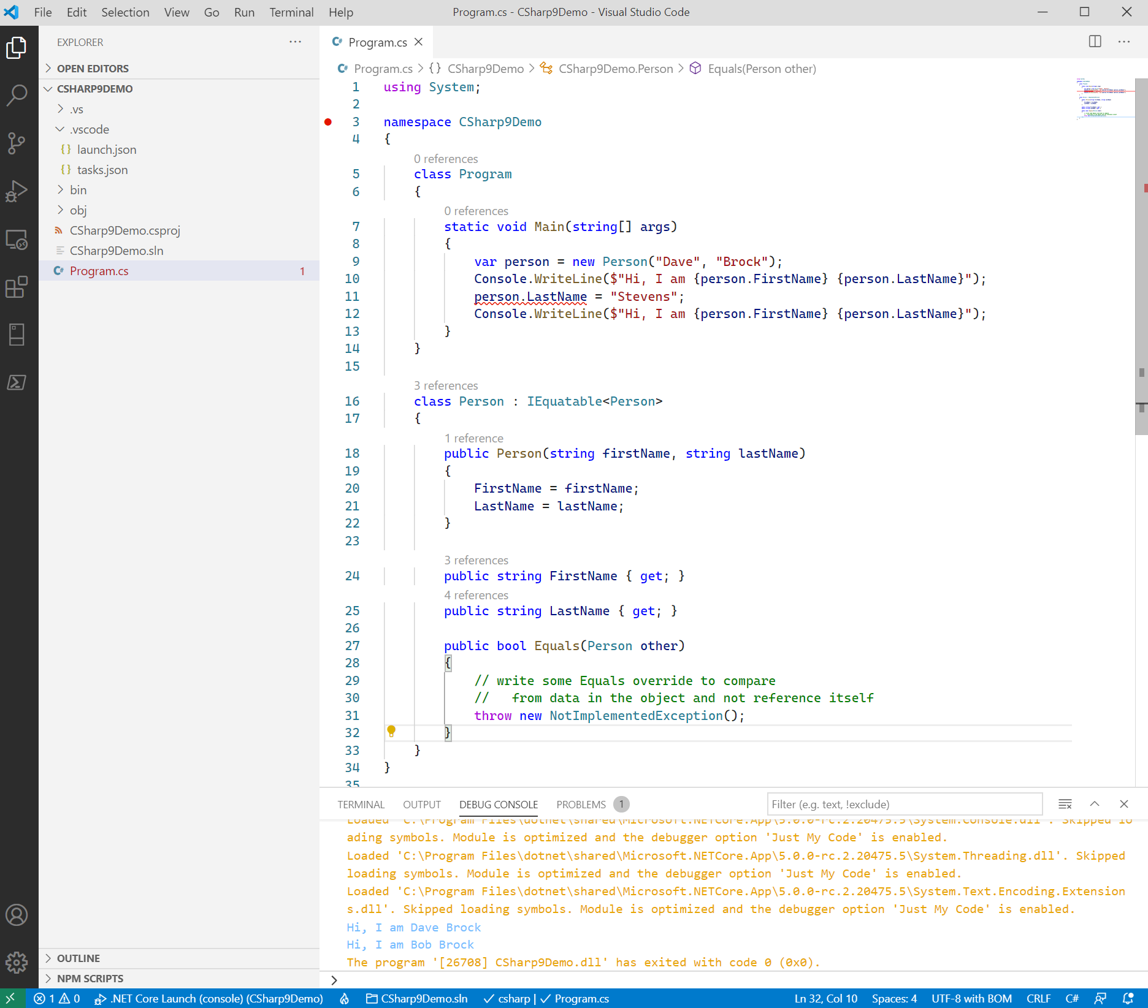
Notes:
Here’s how you would do it with positional records.

Slide 28
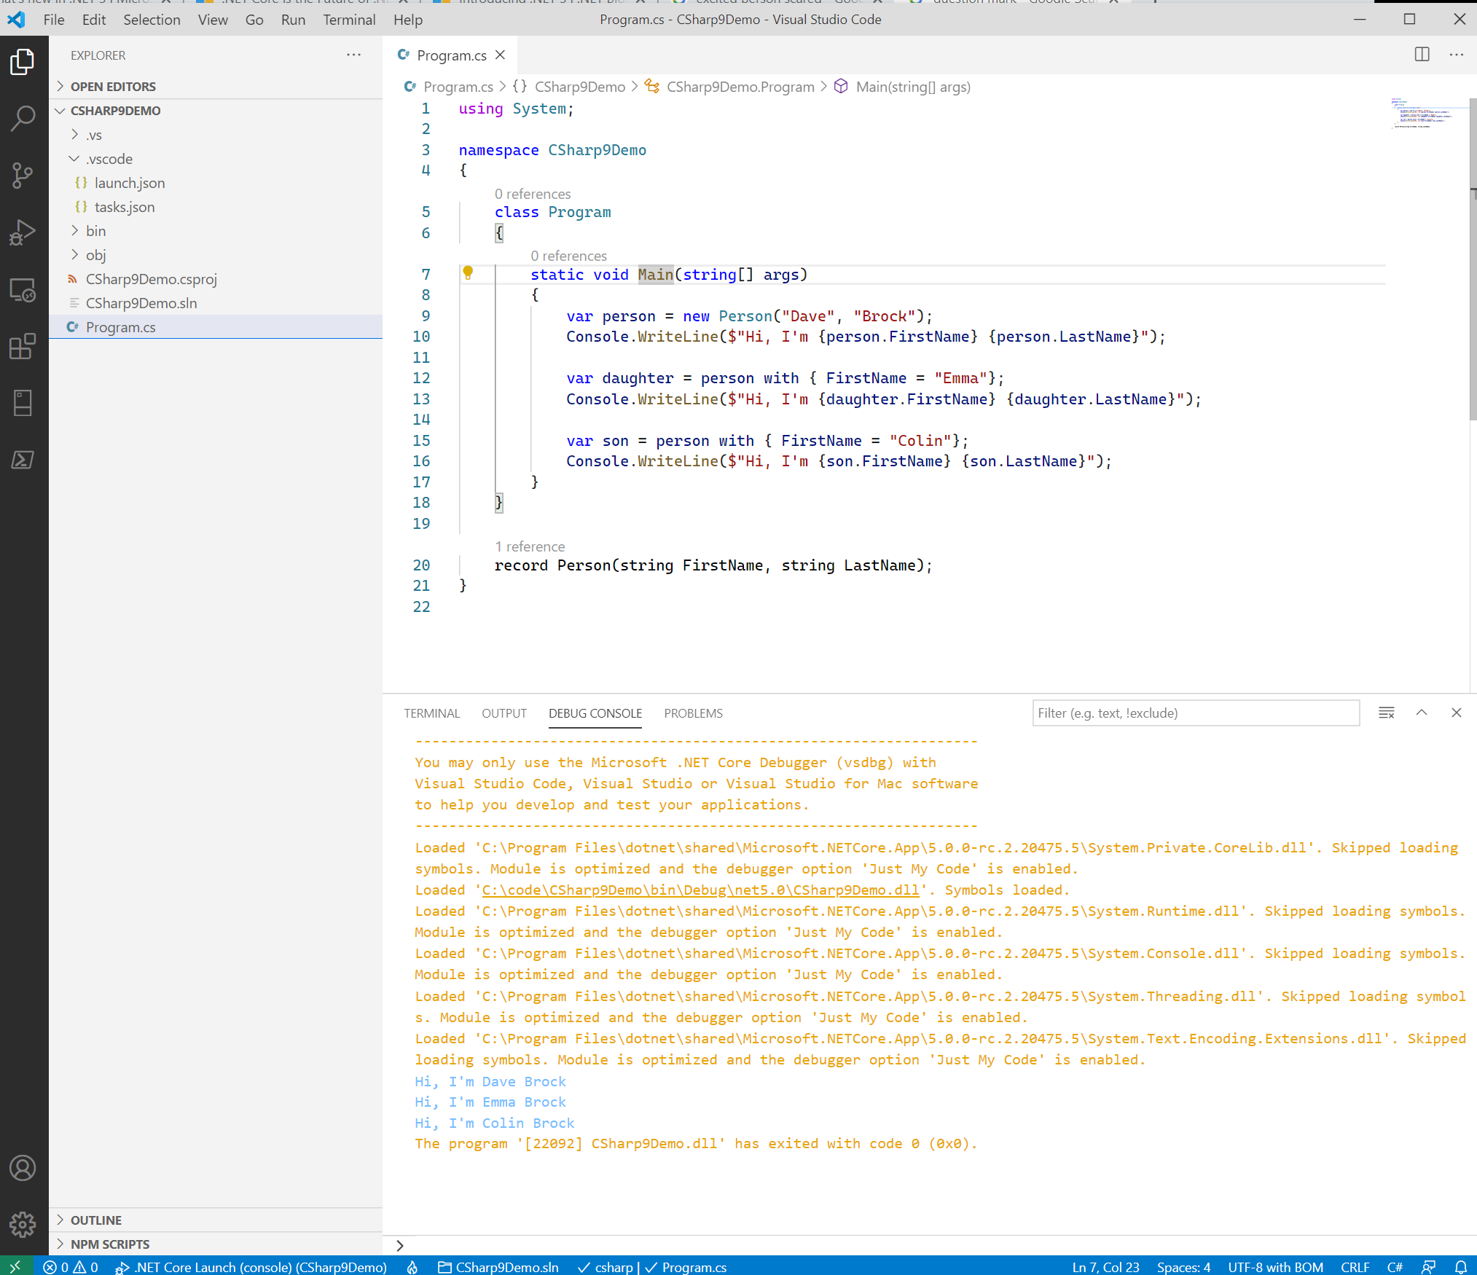
Notes:
Here’s how you would do it with positional records.

Slide 29
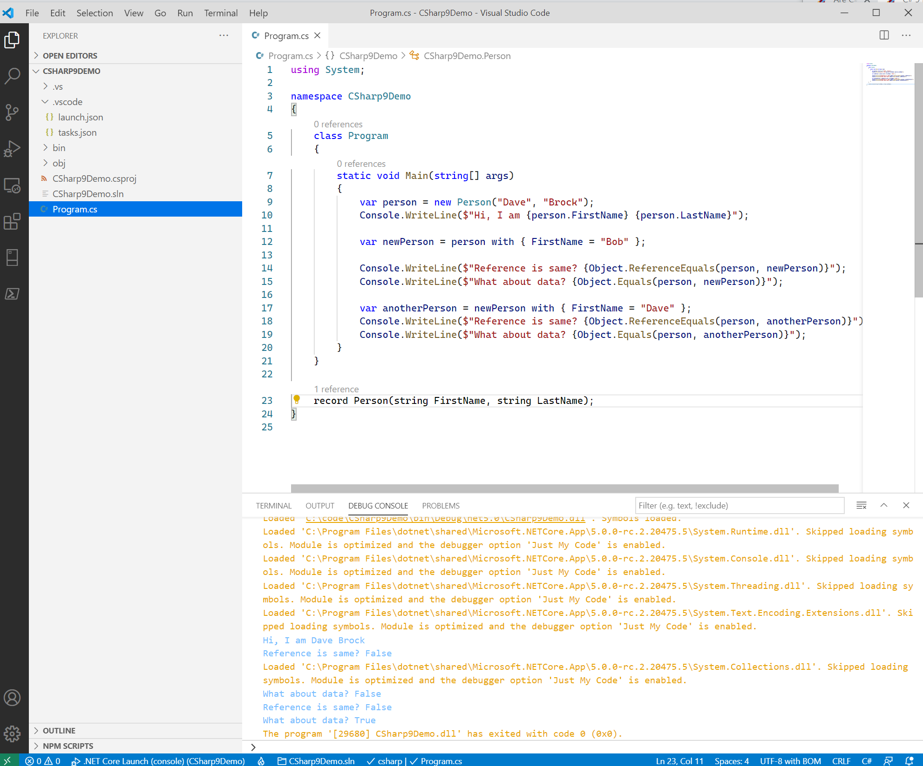
Notes:
Here’s how equality works with “with operators”

Slide 30
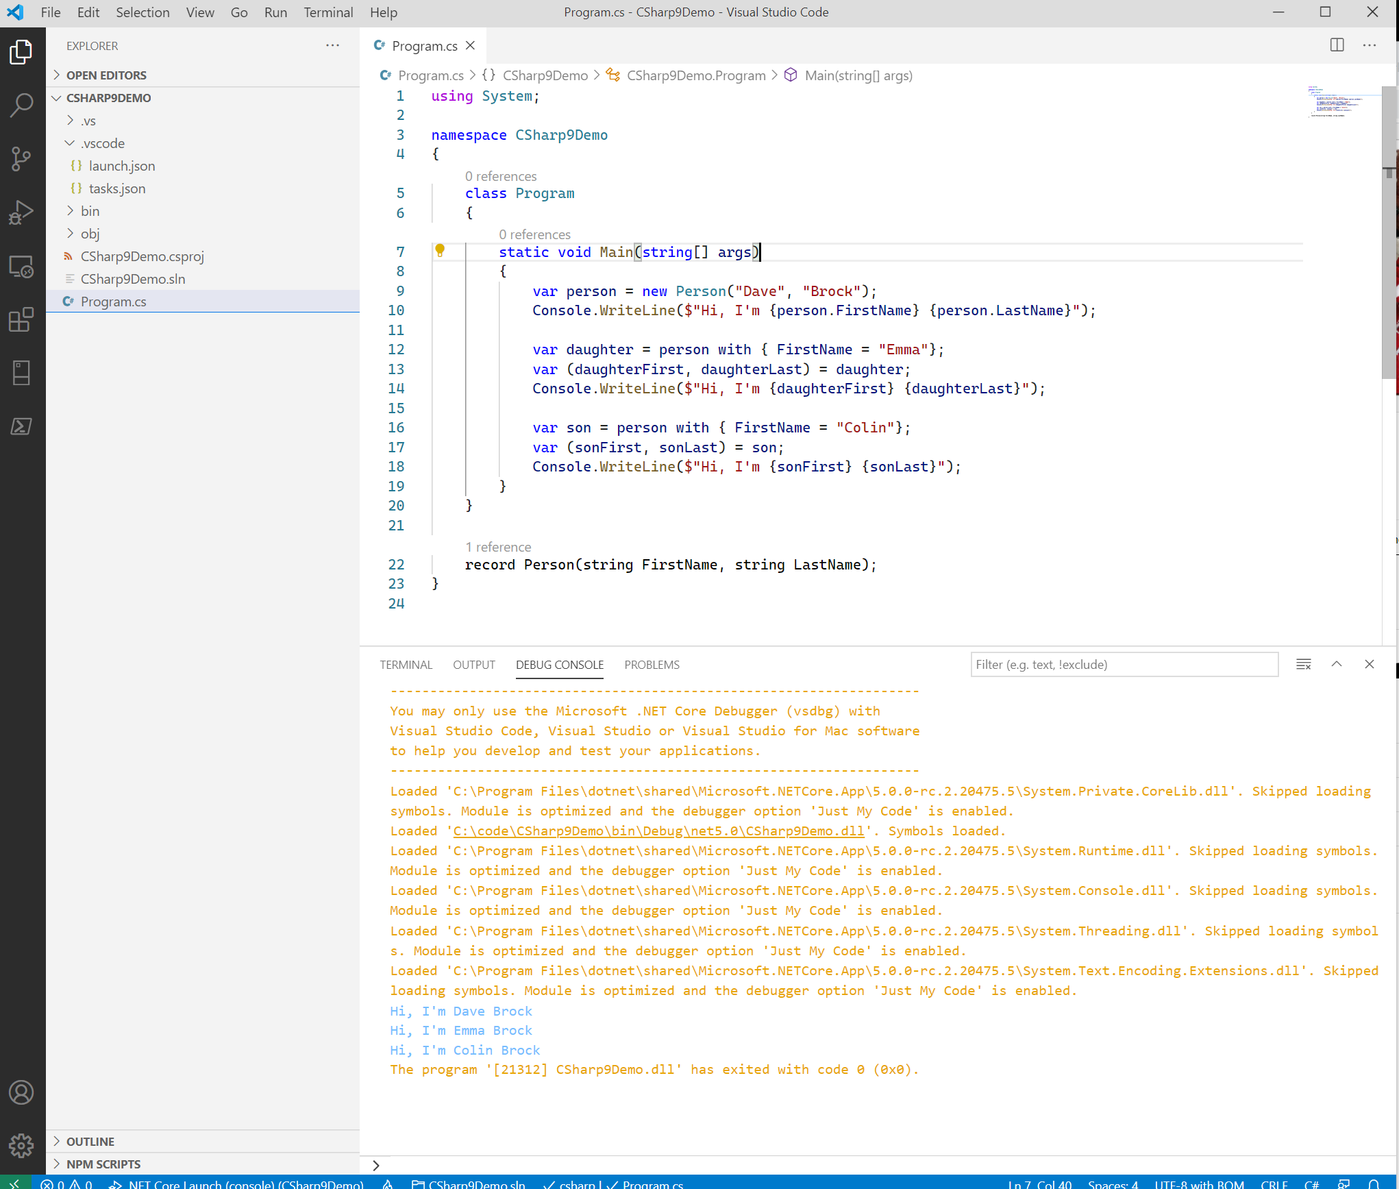
Notes:
Here’s how you would do it with deconstruction.

Slide 31

C# 9: Functionally Better?
From Isaac Abraham, who runs an F# consultancy (Compositional IT):
“On the one hand, for the C# dev it’s great—they have a more powerful toolkit at their disposal. But I would hate to be a new developer starting in C# for the first time. There are so many ways to do things now.
More than that, I worry that we’ll end up with a kind of bifurcated C# ecosystem—those that adopt the new features and those that won’t … and the risk of losing the identity of what C# really is.
I’m interested to see how it works out. Introducing things like records … is going to lead to some new and different design patterns being used that will have to naturally evolve over time.”
@daveabrock daveabrock.com
bit.ly/brock-isaac
@dotnetstacks dotnetstacks.com

Slide 32

C# 9: Functionally Better?
From Phillip Carter, an F# PM at Microsoft:
“You can do immutable programming in C# today, and C# records will help with that. But it’s still a bit of a chore because the rest of the language is just begging you to mutate some variables.
C# is evolving into a more unopinionated language that lets you do just about anything in any way you like…this lack of emphasis on one paradigm over the other can lead to vastly different codebases despite being written in the same language.
Is that okay? I can’t tell. But I think it makes identifying the answer to the question, ‘how should I do this?’ more challenging.”
@daveabrock daveabrock.com
bit.ly/brock-carter
@dotnetstacks dotnetstacks.com

Slide 33
C# 9: Learn More
We’re just scratching the surface! Check out the docs to also learn about…
Pattern matching
Covariant return types
Lambda discards
Local function attributes
Module initializers
Native sized integers
… and much more
@daveabrock daveabrock.com
bit.ly/brock-c9-new
@dotnetstacks dotnetstacks.com

Slide 34

ASP.NET Core/Blazor in .NET 5
Tons of improvements:
Record type support
OpenAPI spec/Swagger F5 support
New Azure AD library
JSON extension methods
dotnet watch support for auto-refresh
We’ll walk through Blazor improvements:
CSS isolation
Component virtualization
Lazy loading
@daveabrock daveabrock.com
@dotnetstacks dotnetstacks.com

Slide 35
It all starts with a simple style
h1 {
font: ‘Comic Sans’
}
@daveabrock daveabrock.com
@dotnetstacks dotnetstacks.com

Slide 36
OK, more specific, then…
.my-heading-for-my-page {
font: ‘Comic Sans’
}
@daveabrock daveabrock.com
@dotnetstacks dotnetstacks.com

Slide 37
Where’d my day go?
h1 !important {
font: ‘Comic Sans’
}
@daveabrock daveabrock.com
@dotnetstacks dotnetstacks.com

Slide 38
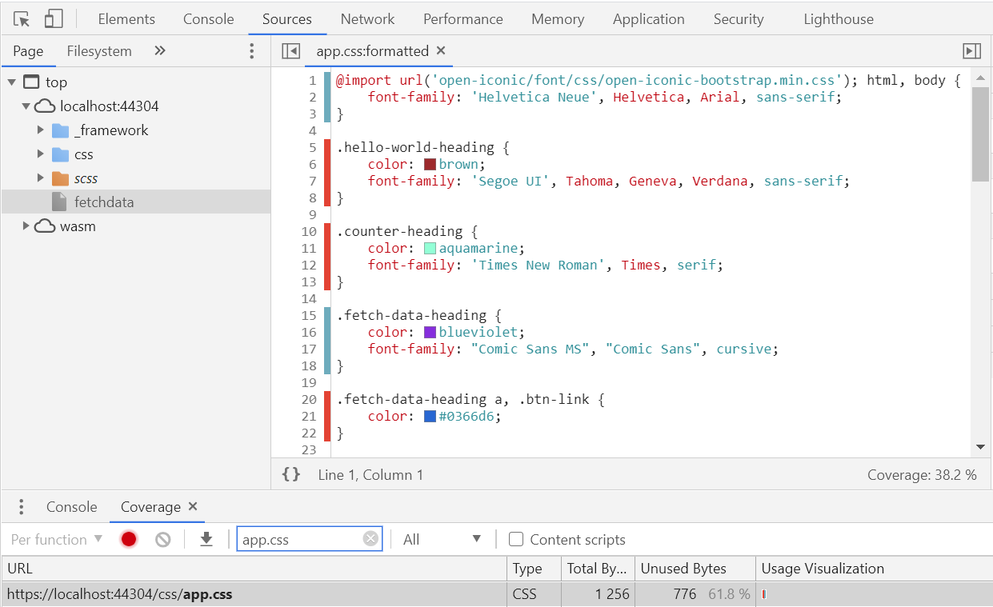
The problem
Component-specific styles can cause bloat, confusion, and issues
Worse yet, your unused styles can incur preventable performance and loading issues
Can’t we just have a way to scope styles to our components only?
@daveabrock daveabrock.com
@dotnetstacks dotnetstacks.com

Slide 39

Blazor CSS isolation
Create a file called MyComponent.styles.css to ensure styles will only be scoped to your component
You can use your h1 knowing it’ll only impact your single component
Seamless integration with preprocessors
@daveabrock daveabrock.com
bit.ly/brock-iso
@dotnetstacks dotnetstacks.com

Slide 40
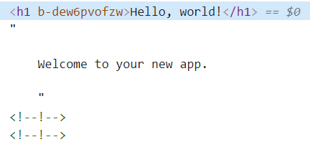
How does this magic work?
(OK, it isn’t magic.)
Blazor appends a scope identifier to your attributes
@daveabrock daveabrock.com
@dotnetstacks dotnetstacks.com

Slide 41
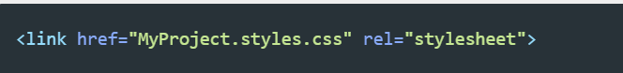
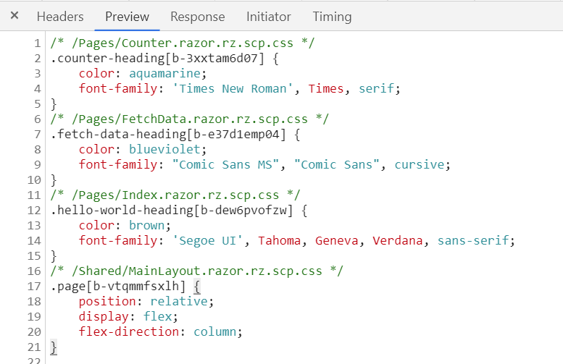
Styles are packaged into a bundle
These are defined in a MyProject.styles.css file
This works for child components and shared libraries, too!
@daveabrock daveabrock.com
@dotnetstacks dotnetstacks.com

Slide 42
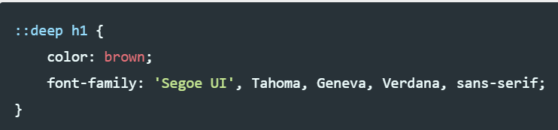
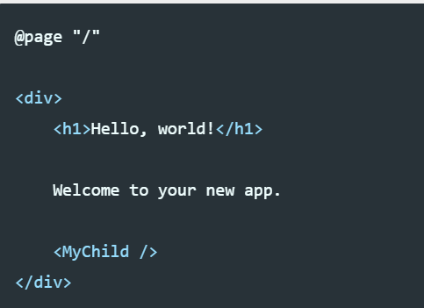
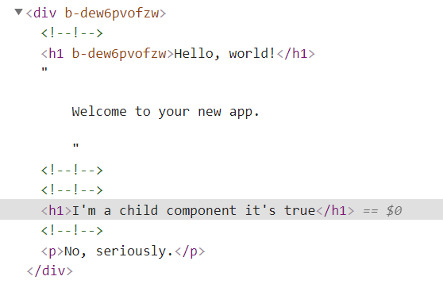
Child component support
You can have your styles cascade to your child components, too, with a ::deep selector
@daveabrock daveabrock.com
@dotnetstacks dotnetstacks.com

Slide 43

Component virtualization
Blazor component virtualization allows you to limit UI rendering to the visible page elements only
Think of tables with thousands of rows
@daveabrock daveabrock.com
bit.ly/brock-virtualization
@dotnetstacks dotnetstacks.com

Slide 44
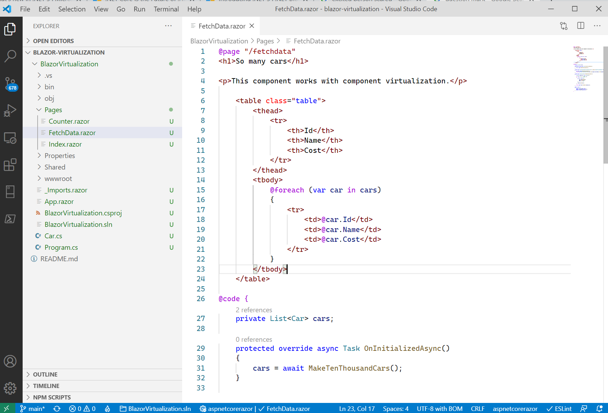

Slide 45
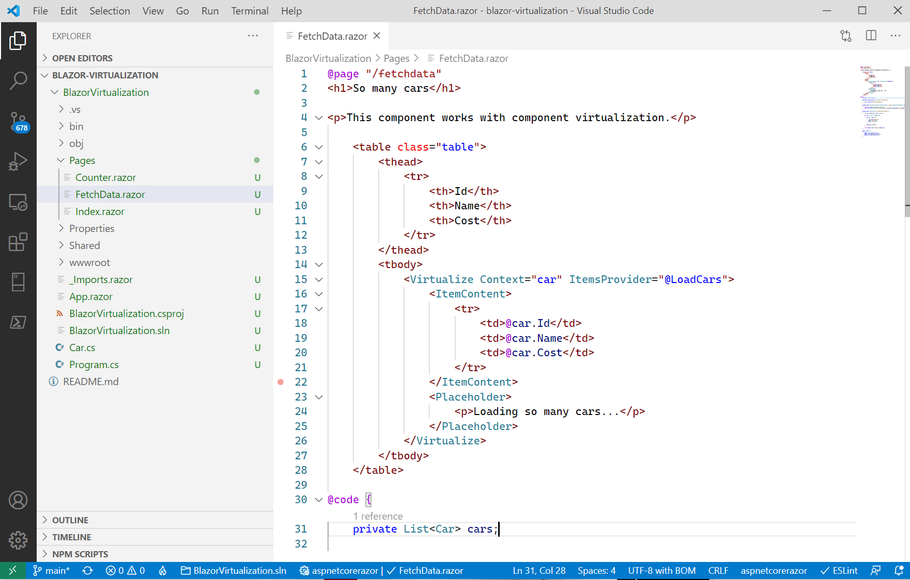

Slide 46
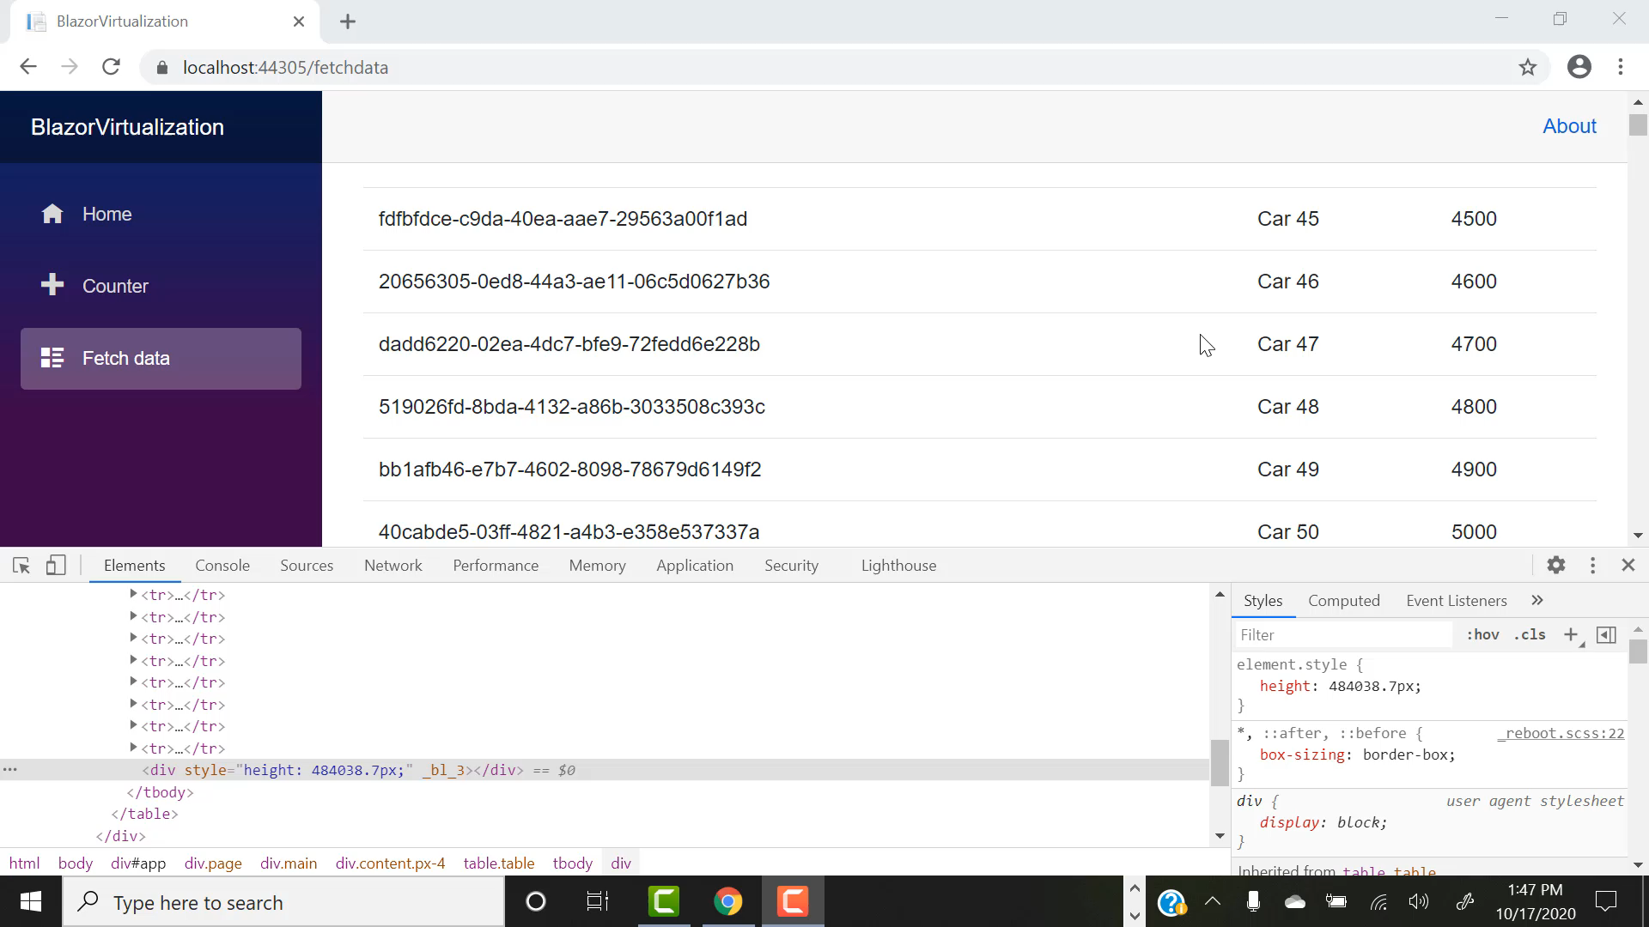
@daveabrock daveabrock.com
@dotnetstacks dotnetstacks.com

Slide 47
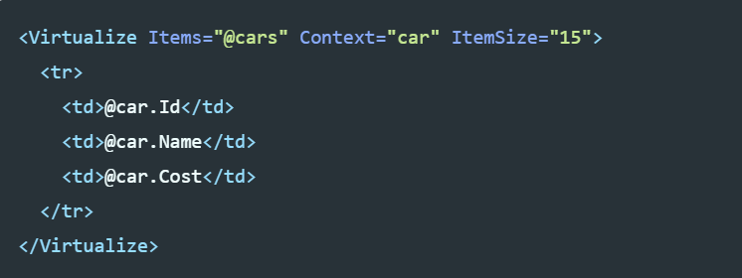
Extend virtualization
Virtualization works great out of the box, but you can extend it even further
You can configure lazy loading to only return a certain amount of items, great for external APIs!
@daveabrock daveabrock.com
@dotnetstacks dotnetstacks.com

Slide 48
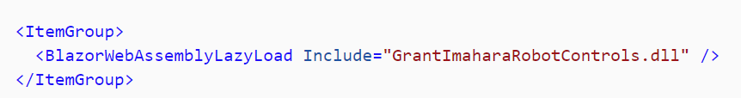
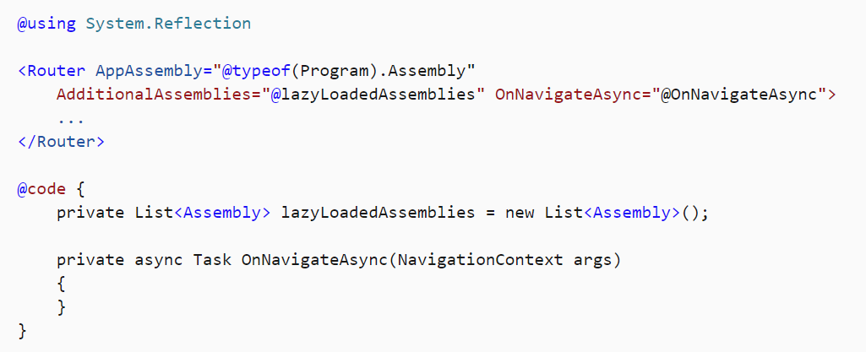
Lazy Load Blazor assemblies
You can improve Blazor Web Assembly app performance by deferring the loading of app assemblies until you need them
You can flag assemblies, which will load when a user navigates to a specific route
@daveabrock daveabrock.com
@dotnetstacks dotnetstacks.com

Slide 49

Entity Framework Core 5 updates
Many-to-many support – you can use many-to-many relationships without the need for a join table
Filtered and split includes – split .Include() into multiple queries
Table-per-type inheritance mapping – Previously, an inheritance hierarchy mapped types to a single table. Now, you can map peach type to a different database table
@daveabrock daveabrock.com
@dotnetstacks dotnetstacks.com

Slide 50

That’s it!
Hit me up on Twitter with any feedback or suggestions
Let me know how .NET 5 works for you!
Geek out at .NET Conf 11/10-11/12 at dotnetconf.net
@daveabrock daveabrock.com
@dotnetstacks dotnetstacks.com

Slide 51
Questions?
@daveabrock daveabrock.com
@dotnetstacks dotnetstacks.com

